Slide 1
TAMING TEXAS Judicial Civics and
Court History Project
Teach Texas Classroom Program
LESSON 2: The Texas Courts
Revised 2/2020

Slide 2
Let’s look back at Lesson 1 before we move forward:
Do you remember what the Rule of Law is?
A system of self-government in which everyone is required to follow the law and everyone is treated equally under the law.
The courts uphold the Rule of Law.
2

Slide 3
Who Makes Sure Everyone is Treated Equally under Texas Law?
The Texas Constitution set up a court system that includes judges elected by the people and juries made up of the people themselves.
The court system has different kinds and levels of courts to make sure decisions follow the law.
3

Slide 4
What is the Difference between Civil Law and Criminal Law?
Civil Law involves private disputes between individuals or organizations. One sues another to receive compensation for harm they claim was done, and the court either awards the compensation or does not.
Criminal Law involves deliberate or reckless acts that break one or more of society’s rules. A person accused of a criminal act is taken to court by the community or state, tried by a jury, and found either guilty or not guilty. The punishment for guilty verdicts is defined by the laws.
4

Slide 5
What is the Difference between a Trial Court and an Appellate Court?
A Trial Court is where a civil or criminal case starts. Both sides present evidence and witnesses to a judge and jury to tell their version of what happened.
If someone disagrees with a Trial Court’s decision, he or she can take (appeal) the case to an Appellate Court. There are no witnesses and no jury, just a panel of judges who decide whether the trial court’s decision followed the law.
5

Slide 6
Which Courts Do What in Texas?
Before moving to the next slides, we’ll do a classroom exercise on the Texas Courts.
6
Notes:
This is when the students are asked to organize the Texas Courts sheets by level of court, from the highest to the lowest level. The next slide—a blank chart—can be shown while they work on the exercise.

Slide 7
COURT STRUCTURE OF TEXAS
7
Notes:
This is a blank court structure chart that students can look at as they arrange the courts sheets from bottom to top.

Slide 8
A Quick Summary of Texas Courts, Lowest to Highest
Cases that involve fines but no jail time are handled by two kinds of local trial courts:
1. Justice (or Justice of the Peace) Courts
Traffic fines
School truancy cases
Civil lawsuits with damages up to $10,000
8

Slide 9
Another kind of local trial court…
2. Municipal Courts
Criminal violations related to fire safety, public health, etc.
Misdemeanor cases (like theft of property worth less than $50 or driving while intoxicated) originating within city limits.
Cases involving dangerous dogs.
9

Slide 10
Trial Courts at the Next Level:
County-Level Courts
Criminal cases punishable with fines of $500+ or 1 year in jail.
Civil cases with damages of at least $200.
Civil cases involving wills and estates.
Juvenile cases involving youths under age 17.
10

Slide 11
Trial Courts at the Highest Level:
District Courts
Civil cases involving land disputes, contested elections, lawsuits claiming damages over $200.
Civil cases involving family laws (divorce, child custody, adoptions, etc.)
Serious criminal cases called felonies (murder, armed robbery, arson of a home or church, etc.).
11

Slide 12
Appellate Courts at the First Level
• 14 Courts of Appeals hear both civil and criminal cases appealed from county and district courts.
12

Slide 13
Appellate Courts at the Highest Level
Texas is one of only two states with two “supreme” courts.
• The Texas Supreme Court is the highest court for civil appeals.
• The Texas Court of Criminal Appeals is the highest court for criminal appeals.
13

Slide 14
COURT STRUCTURE OF TEXAS
Supreme Court of Texas
1 court, 9 justices
Texas Court of Criminal Appeals
1 court, 9 judges
Civil Appeals
Criminal Appeals
Courts of Appeals
14 courts, 80 justices
Death Penalty
District Courts
469 courts, 469 judges
County-Level Courts
518 courts, 518 judges
Justice of the Peace Courts
802 courts, 802 judges
Municipal Courts
938 courts, 1,326 judges
14
Numbers as of 1/2018
Notes:
The number of trial courts changes every year. The number of Courts of Appeals, Supreme Court, and Court of Criminal Appeals are set by the Texas Constitution.

Slide 15
I Know Someone Who…
See if you can tell what court would hear
each of the following cases.
15

Slide 16
I Know Someone Who…
Was upset because he found out that his parents were filing for divorce.
What court would hear this case?
16
Notes:
Answer: District Court

Slide 17
I Know Someone Who…
Stole several video games from a store and faced a fine of $700 and
up to six months in jail.
What court would hear this case?
17
Notes:
County Court

Slide 18
I Know Someone Who…
Ran around with a bad crowd who convinced him to spray paint the side of a building. The owner of the building caught him and sued him for the $150 in damage he’d caused.
What court would hear this case?
18
Notes:
Justice of the Peace Court

Slide 19
I Know Someone Who…
Got a ticket because his dog was not on a leash at a city dog park.
What court would hear this case?
19
Notes:
Municipal Court

Slide 20
I Know Someone Who…
Was convicted of a felony (serious crime) and appealed his case.
What court would hear this case?
20
Notes:
Court of Appeals

Slide 21
I Know Someone Who…
Lost his appeal of a felony conviction and decided to appeal a second time.
What court would hear this case?
21
Notes:
Court of Criminal Appeals

Slide 22
I Know Someone Who…
Had just learned to drive and was pulled over by a police officer for speeding in a school zone.
What court would hear this case?
22
Notes:
Municipal Court

Slide 23
I Know Someone Who…
Wrote false things about Suzy on Facebook and Suzy sued her for $100,000 and won. My friend appealed her case to the highest court in Texas.
What court would hear this case?
23
Notes:
Texas Supreme Court

Slide 24
A Quick Look at Federal Courts
• The U.S. Constitution is the supreme law of the land in the United States.
• It creates a federal system of government in which power is shared between the federal government and the state governments.
• Due to this federalism, the federal government and each of the state governments have their own court systems.
24
Notes:
The sharing of power between the U.S. government and the state governments is very important.

Slide 25
What Kinds of Cases Do Federal Courts Hear?
Cases that deal with whether a law is constitutional under the U.S. Constitution (for example, if a law passed by the Texas Legislature is in conflict with an individual’s right to free speech).
Cases that involve laws and treaties of the United States.
Disputes between two or more states.
25
Notes:
In comparison, Texas courts hear most criminal cases, probate cases (involving wills and estates), and most civil cases, including contract cases, tort cases (personal injuries), and family law cases. Texas courts are the final arbiters of the Texas Constitution and laws. Federal courts may hear cases concerning state laws if the issue is whether the state law violates the federal Constitution.

Slide 26
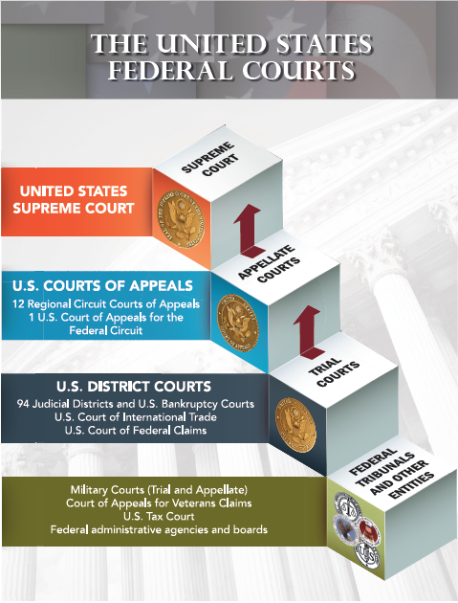
26
Notes:
The federal court system has trial courts and appellate courts, with the U.S. Supreme Court being the highest court.

Slide 27
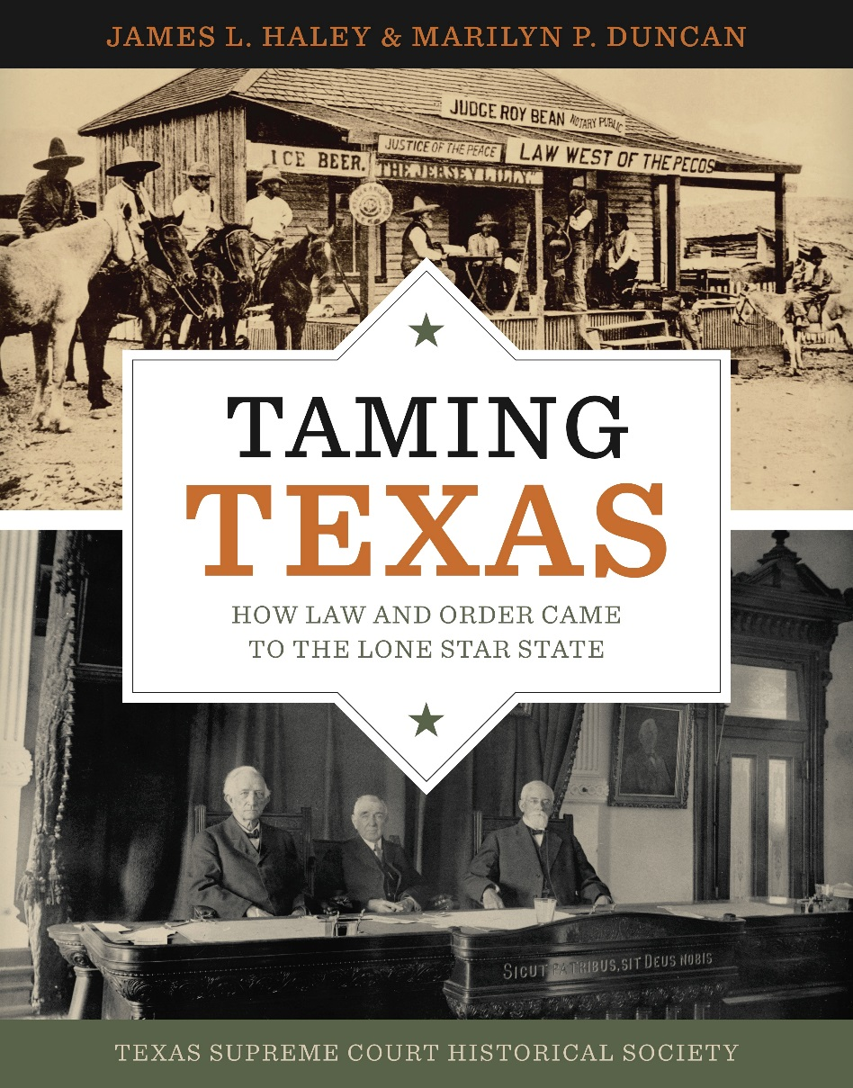
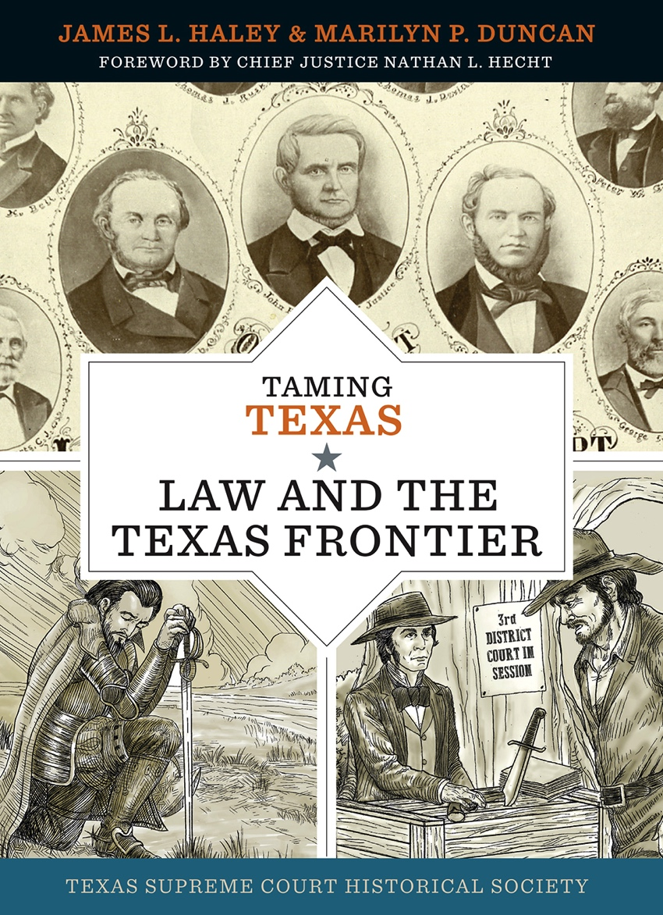
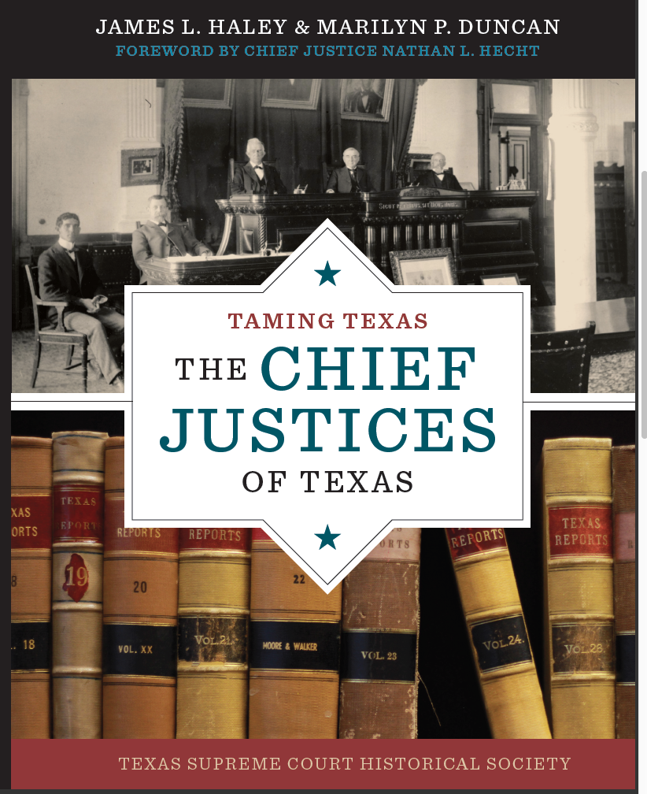
TAMING TEXAS Books
Notes:
Your teach has a copy of each of the Taming Texas books. You can find out much more about Texas courts and law in the books.

